Slide 1
Efficient Algorithms
Ekkapot Charoenwanit
Software Systems Engineering
TGGS
KMUTNB

Slide 2
Lecture 6: Divide and Conquer

Slide 3
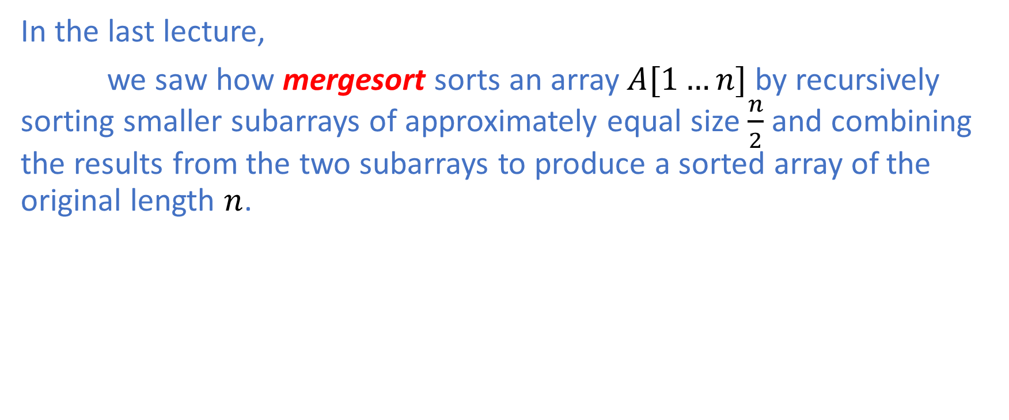
Divide and Conquer
In the last lecture,
we saw how mergesort sorts an array $A[1…n]$ by recursively sorting smaller subarrays of approximately equal size $\frac{n}{2}$ and combining the results from the two subarrays to produce a sorted array of the original length $n$.

Slide 4
Divide and Conquer: The Three-Step Process
Generally, in the divide-and-conquer paradigm , we solve a problem by recursively, applying the following three steps at each level of recursion:
Divide the problem into a number of smaller subproblems that are smaller instances of the same problem
Conquer the subproblems by solving them recursively. However, if the sizes of subproblems are small enough, simply solve these subproblems in a straightforward way without the need to divide any further
Combine the solutions to the subproblems into the solution to the original problem

Slide 5
Divide and Conquer: Recursion
When the subproblems are large enough to solve recursively, we call such cases the recursive case.
Once the subproblems become small enough that we do not recurse anymore, we say that the recursion “bottoms out” and that we have reached the base case.
***In addition to the subproblems that are smaller instances of the same problem, we sometimes need to solve subproblems that are not quite the same as the original subproblem. We consider solving such subproblems in the combine step.

Slide 6
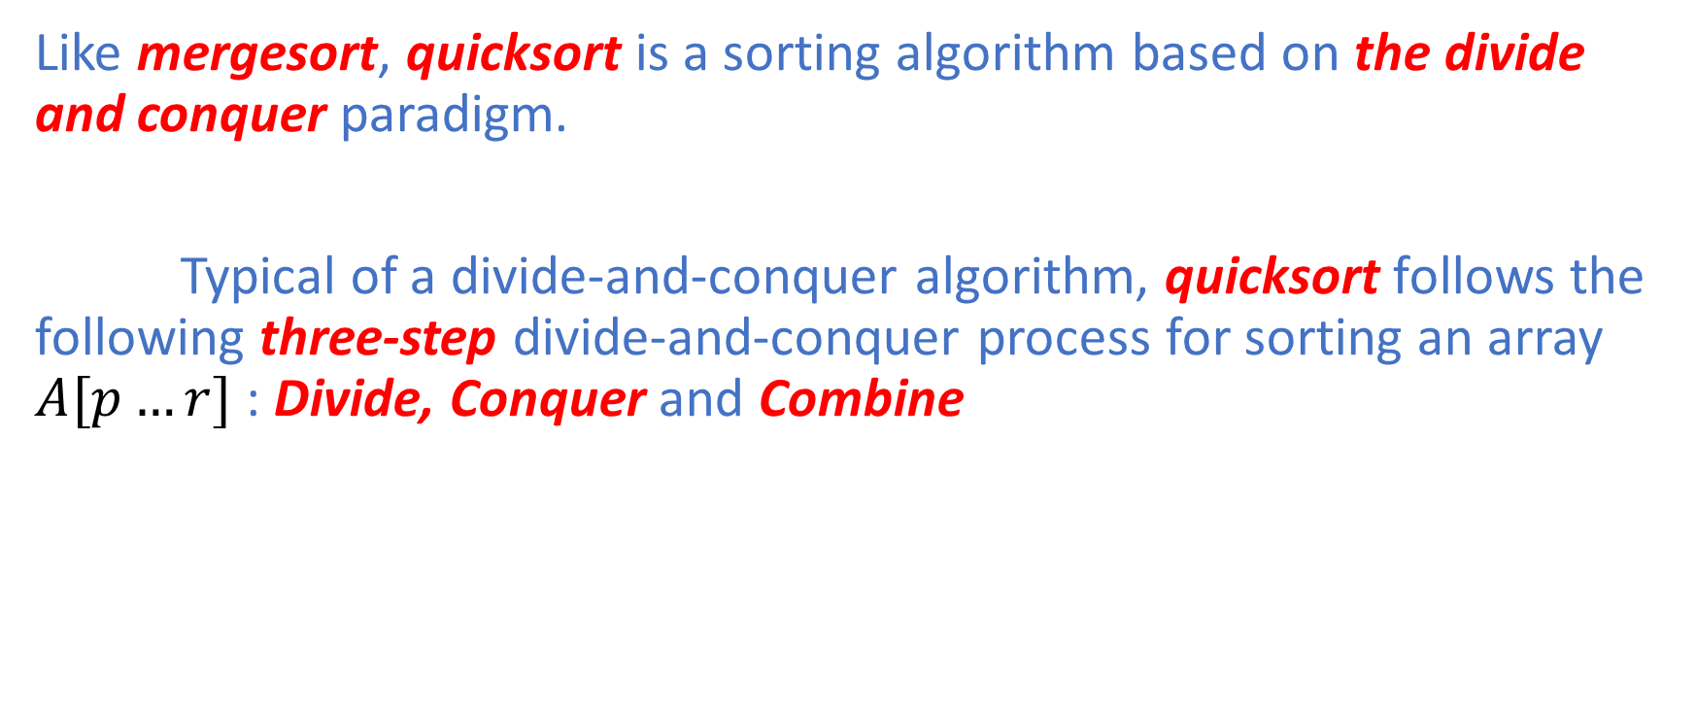
Quicksort
Like mergesort, quicksort is a sorting algorithm based on the divide and conquer paradigm.
Typical of a divide-and-conquer algorithm, quicksort follows the following three-step divide-and-conquer process for sorting an array $A[p…r]$ : Divide, Conquer and Combine

Slide 7
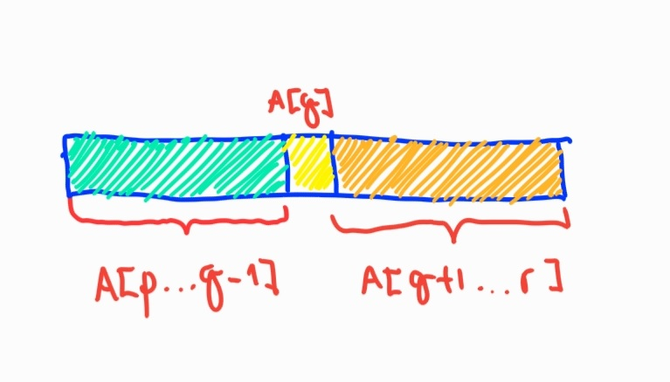
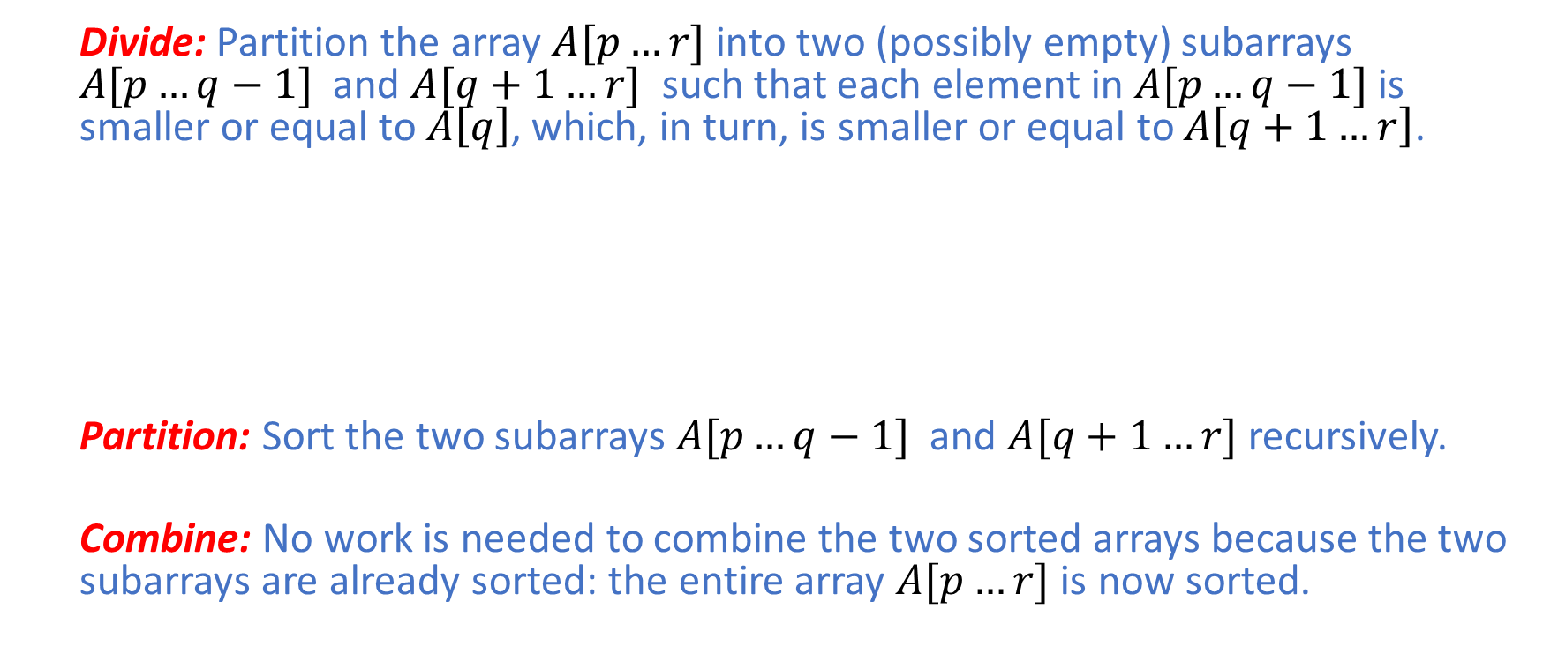
Quicksort: The Three-Step Process
Divide: Partition the array $A[p…r]$ into two (possibly empty) subarrays $A[p…q−1]$ and $A[q+1…r]$ such that each element in $A[p…q−1]$ is smaller or equal to $A\left[q\right]$, which, in turn, is smaller or equal to $A\left[q+1…r\right]$.
Partition: Sort the two subarrays $A[p…q−1]$ and $A[q+1…r]$ recursively.
Combine: No work is needed to combine the two sorted arrays because the two subarrays are already sorted: the entire array $A[p…r]$ is now sorted.

Slide 8
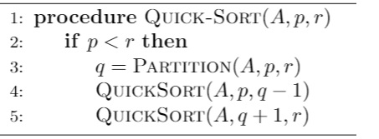

Quicksort: Pseudocode
To sort an entire array, $QuickSort(A,1,A.length)$ is initially called.
The key part of the algorithm is to partition the array as shown in the figure.

Slide 9
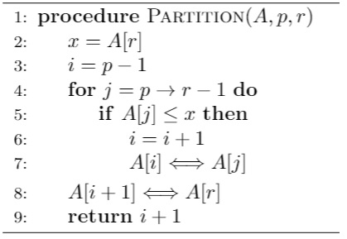
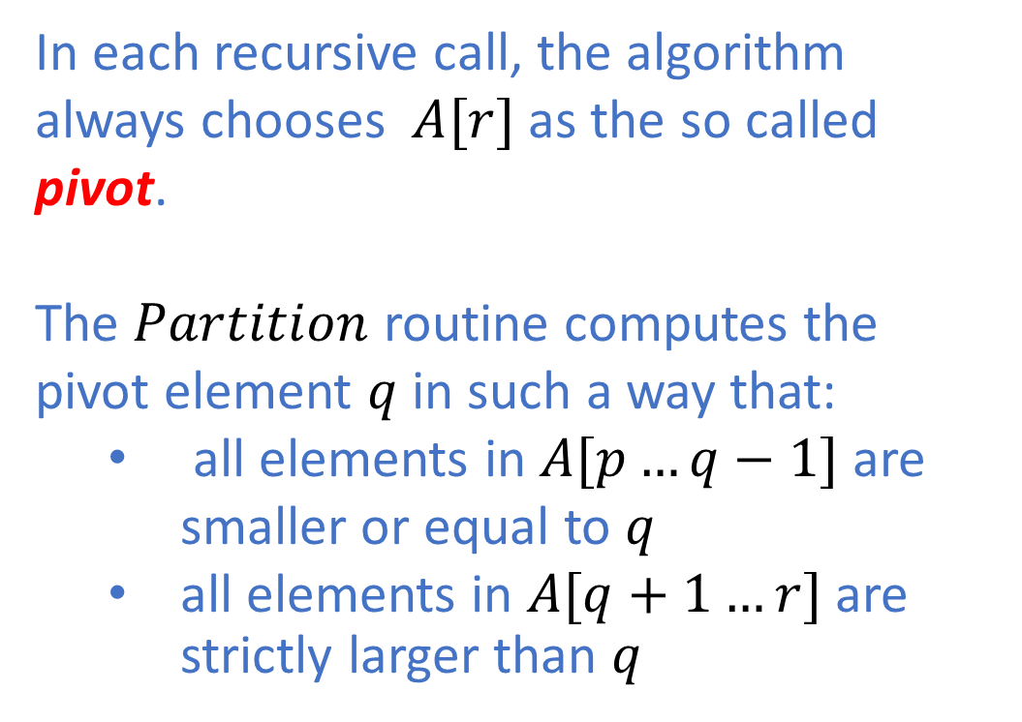
Quicksort: Partitioning
In each recursive call, the algorithm always chooses $A[r]$ as the so called pivot.
The $Partition$ routine computes the pivot element $q$in such a way that:
all elements in $A[p…q−1]$ are smaller or equal to $q$
all elements in $A[q+1…r]$ are strictly larger than $q$

Slide 10
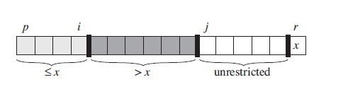
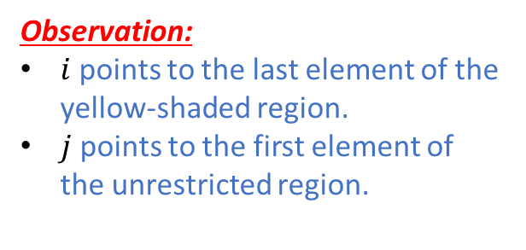
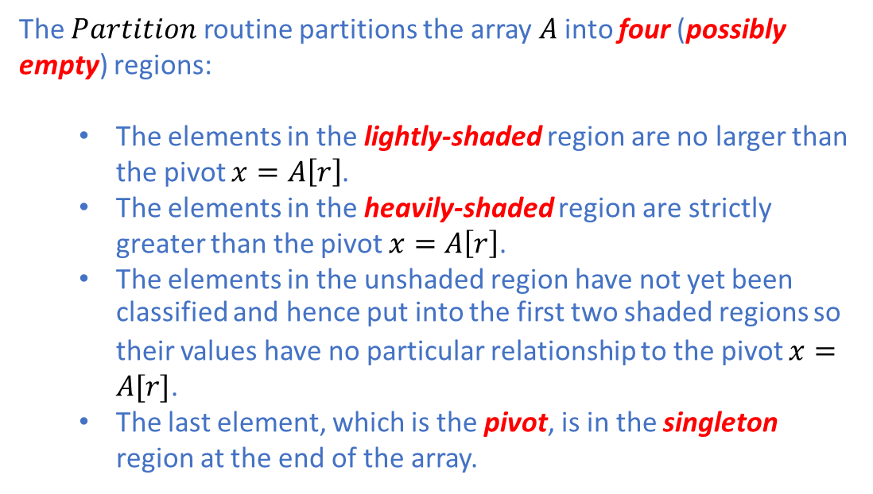
Quicksort: Pictorially
The $Partition$ routine partitions the array $A$into four (possibly empty) regions:
The elements in the lightly-shaded region are no larger than the pivot $x=A\left[r\right]$.
The elements in the heavily-shaded region are strictly greater than the pivot $x=A\left[r\right]$.
The elements in the unshaded region have not yet been classified and hence put into the first two shaded regions so their values have no particular relationship to the pivot $x=A[r]$.
The last element, which is the pivot, is in the singleton region at the end of the array.
Observation:
$i$ points to the last element of the yellow-shaded region.
$j$ points to the first element of the unrestricted region.
***Picture taken from CLRS

Slide 11

Quicksort: Loop Invariant
At the start of each iteration of lines 4-7 for any array index $k$,
If $p≤k≤i$, then $A\left[k\right]≤x$.
If $i+1≤k≤j−1$, then $A\left[k\right]>x$.
If $k=r$, $A\left[k\right]=x$.
***Picture taken from CLRS

Slide 12
Quicksort: Correctness
To prove correctness, we need to show that:
the loop invariant is true prior to the start of the first iteration
the loop invariant is maintained at each iteration
the loop invariant provides a useful property to show correctness when the loop terminates

Slide 13

Quick sort: Correctness
Initialization:
Prior to the start of the first iteration, $i=p−1$ and $j=p$. The first two regions are initially empty so the first two invariant properties trivially hold, i.e., $F→T≡T$. The third invariant property initially holds because of the assignment $x=A[r]$ in Line 2.

Slide 14
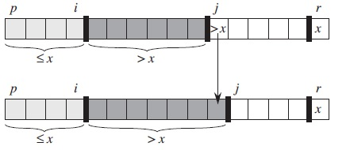
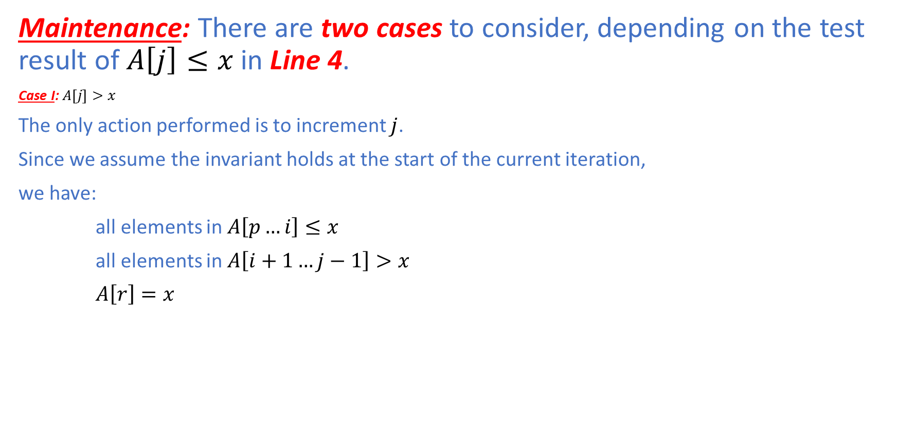
Quicksort: Correctness
Maintenance: There are two cases to consider, depending on the test result of $A\left[j\right]≤x$ in Line 4.
Case I: $A\left[j\right]>x$
The only action performed is to increment $j$.
Since we assume the invariant holds at the start of the current iteration,
we have:
all elements in $A\left[p…i\right]≤x$
all elements in $A\left[i+1…j−1\right]>x$
$A\left[r\right]=x$
***Picture taken from CLRS

Slide 15
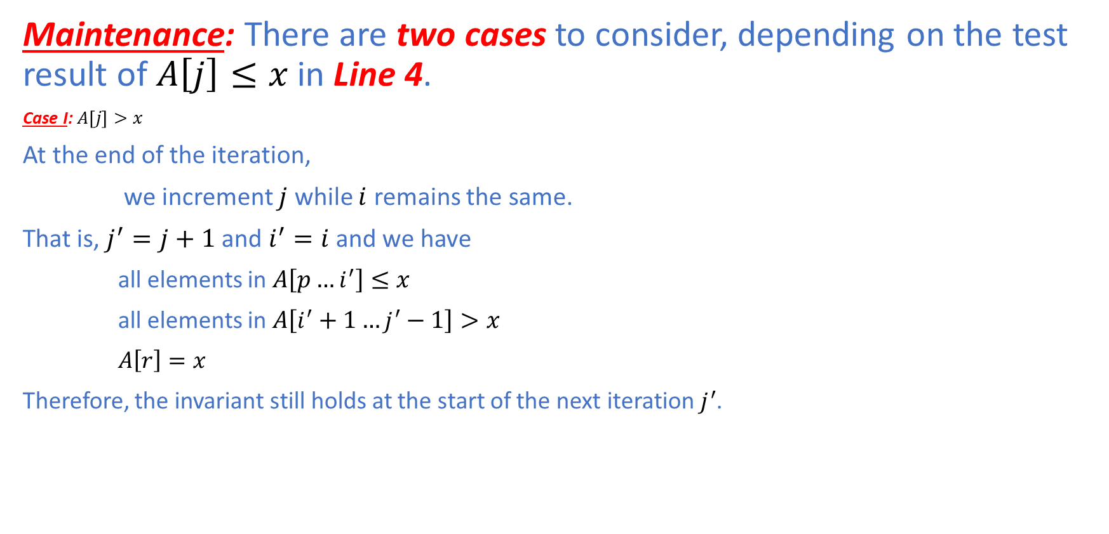
Quicksort: Correctness
Maintenance: There are two cases to consider, depending on the test result of $A\left[j\right]≤x$ in Line 4.
Case I: $A\left[j\right]>x$
At the end of the iteration,
we increment $j$ while $i$ remains the same.
That is, $j^{′}=j+1$ and $i^{′}=i$ and we have
all elements in $A\left[p…i^{′}\right]≤x$
all elements in $A\left[i^{′}+1…j^{′}−1\right]>x$
$A\left[r\right]=x$
Therefore, the invariant still holds at the start of the next iteration $j^{′}$.
***Picture taken from CLRS

Slide 16
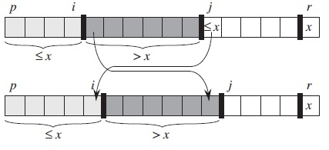
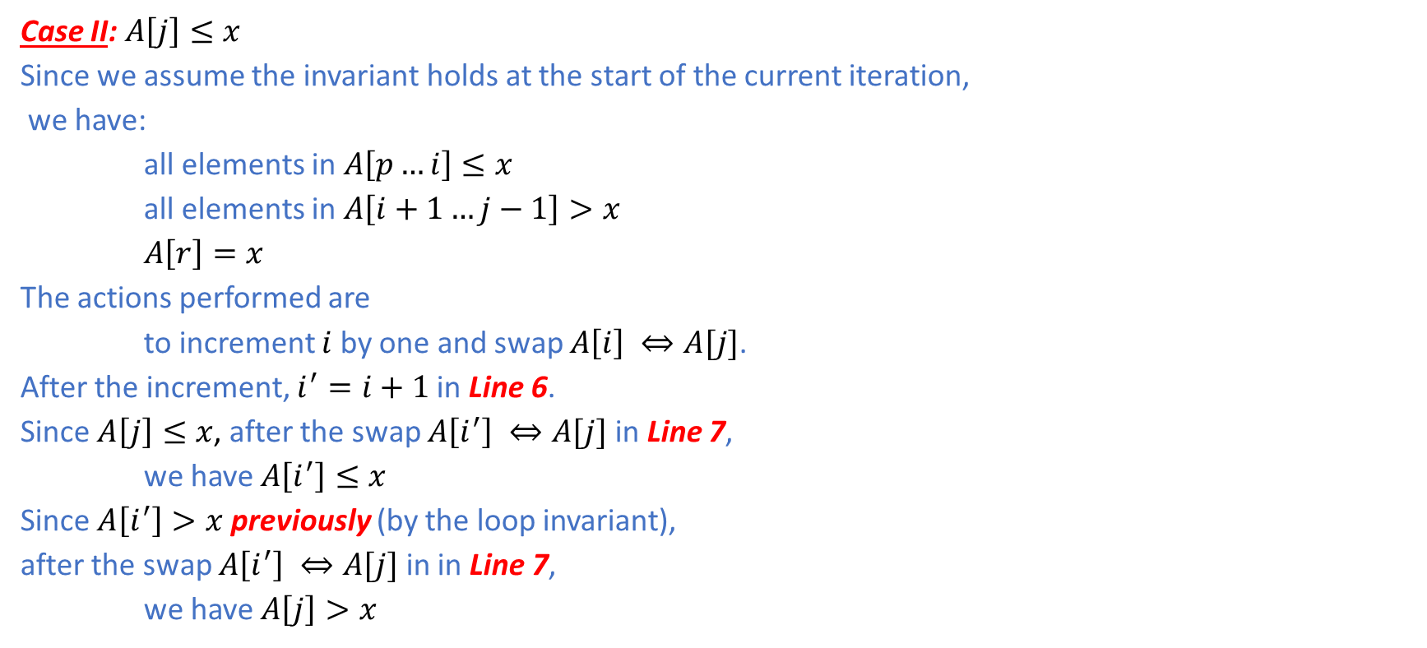
Quicksort: Correctness
Case II: $A\left[j\right]≤x$
Since we assume the invariant holds at the start of the current iteration,
we have:
all elements in $A\left[p…i\right]≤x$
all elements in $A\left[i+1…j−1\right]>x$
$A\left[r\right]=x$
The actions performed are
to increment $i$ by one and swap $A\left[i\right] ⇔A[j]$.
After the increment, $i^{′}=i+1$ in Line 6.
Since $A\left[j\right]≤x$, after the swap $A\left[i^{′}\right] ⇔A[j]$ in Line 7,
we have $A\left[i^{′}\right]≤x$
Since $A\left[i^{′}\right]>x$ previously (by the loop invariant),
after the swap $A\left[i^{′}\right] ⇔A[j]$ in in Line 7,
we have $A\left[j\right]>x$
***Picture taken from CLRS

Slide 17
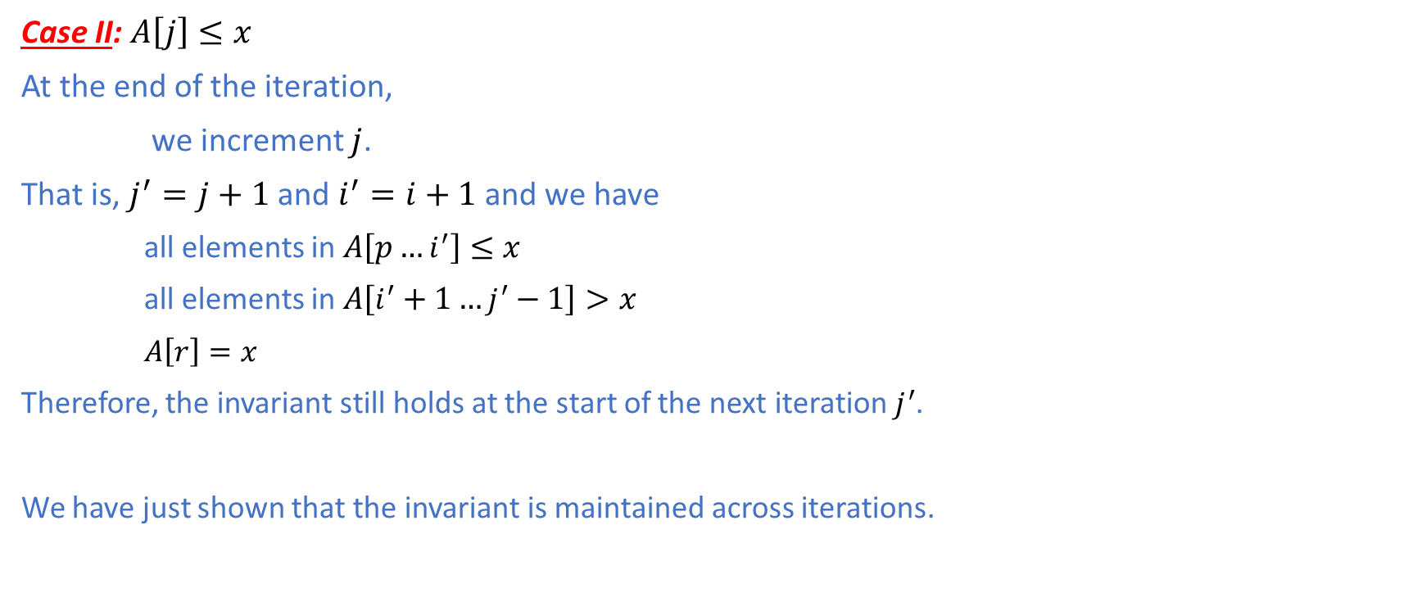
Quicksort: Correctness
Case II: $A\left[j\right]≤x$
At the end of the iteration,
we increment $j$.
That is, $j^{′}=j+1$ and $i^{′}=i+1$ and we have
all elements in $A\left[p…i^{′}\right]≤x$
all elements in $A\left[i^{′}+1…j^{′}−1\right]>x$
$A\left[r\right]=x$
Therefore, the invariant still holds at the start of the next iteration $j^{′}$.
We have just shown that the invariant is maintained across iterations.
***Picture taken from CLRS

Slide 18
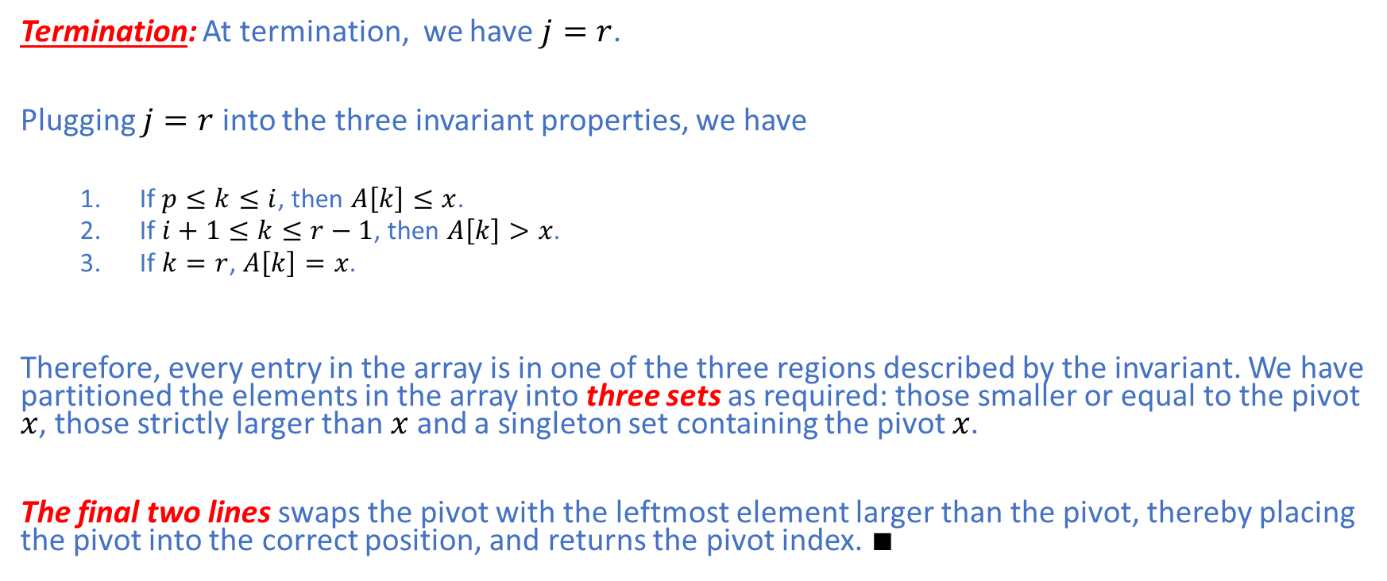
Quicksort: Correctness
Termination: At termination, we have $j=r$.
Plugging $j=r$ into the three invariant properties, we have
If $p≤k≤i$, then $A\left[k\right]≤x$.
If $i+1≤k≤r−1$, then $A\left[k\right]>x$.
If $k=r$, $A\left[k\right]=x$.
Therefore, every entry in the array is in one of the three regions described by the invariant. We have partitioned the elements in the array into three sets as required: those smaller or equal to the pivot $x$, those strictly larger than $x$ and a singleton set containing the pivot $x$.
The final two lines swaps the pivot with the leftmost element larger than the pivot, thereby placing the pivot into the correct position, and returns the pivot index. $∎$

Slide 19
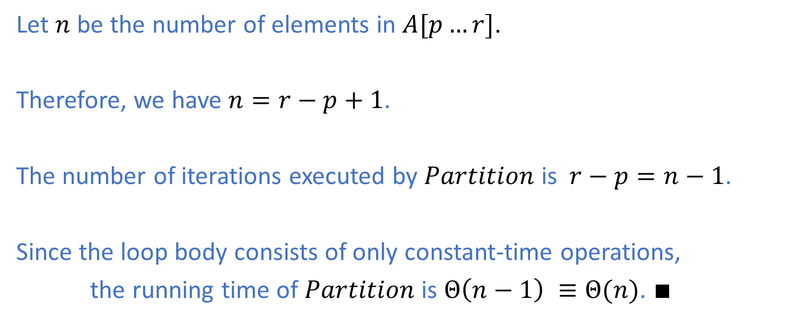
Quicksort: Analysis of Partitioning
Let $n$ be the number of elements in $A[p…r]$.
Therefore, we have $n=r−p+1$.
The number of iterations executed by $Partition$ is $r−p=n−1$.
Since the loop body consists of only constant-time operations,
the running time of $Partition$ is $Θ\left(n−1\right) ≡Θ(n)$. $∎$

Slide 20
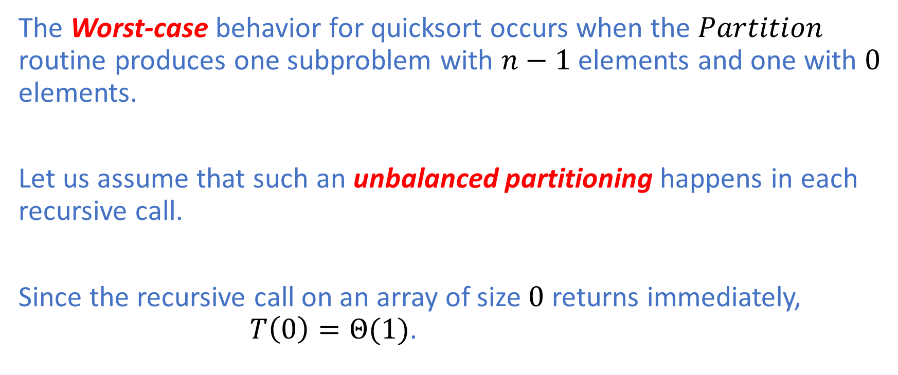
Quick sort: Worst-Case Analysis
The Worst-case behavior for quicksort occurs when the $Partition$ routine produces one subproblem with $n−1$ elements and one with $0$ elements.
Let us assume that such an unbalanced partitioning happens in each recursive call.
Since the recursive call on an array of size $0$ returns immediately, $T\left(0\right)=Θ(1)$.

Slide 21

Quicksort: Worst-Case Analysis
Therefore, the running time of quicksort is
$$T\left(n\right)=T\left(n−1\right)+T\left(0\right)+Θ(n)$$
Since $T\left(0\right)=Θ\left(1\right)$,
$$T\left(n\right)=T\left(n−1\right)+Θ(1)+Θ(n)$$
The $Θ(1)$ term can be absorbed into the more asymptotically dominant $Θ(n)$
term.
Therefore,
$$T\left(n\right)=T\left(n−1\right)+Θ(n)$$
Solving the recurrence, we have $T\left(n\right)=Θ(n^{2})$.

Slide 22
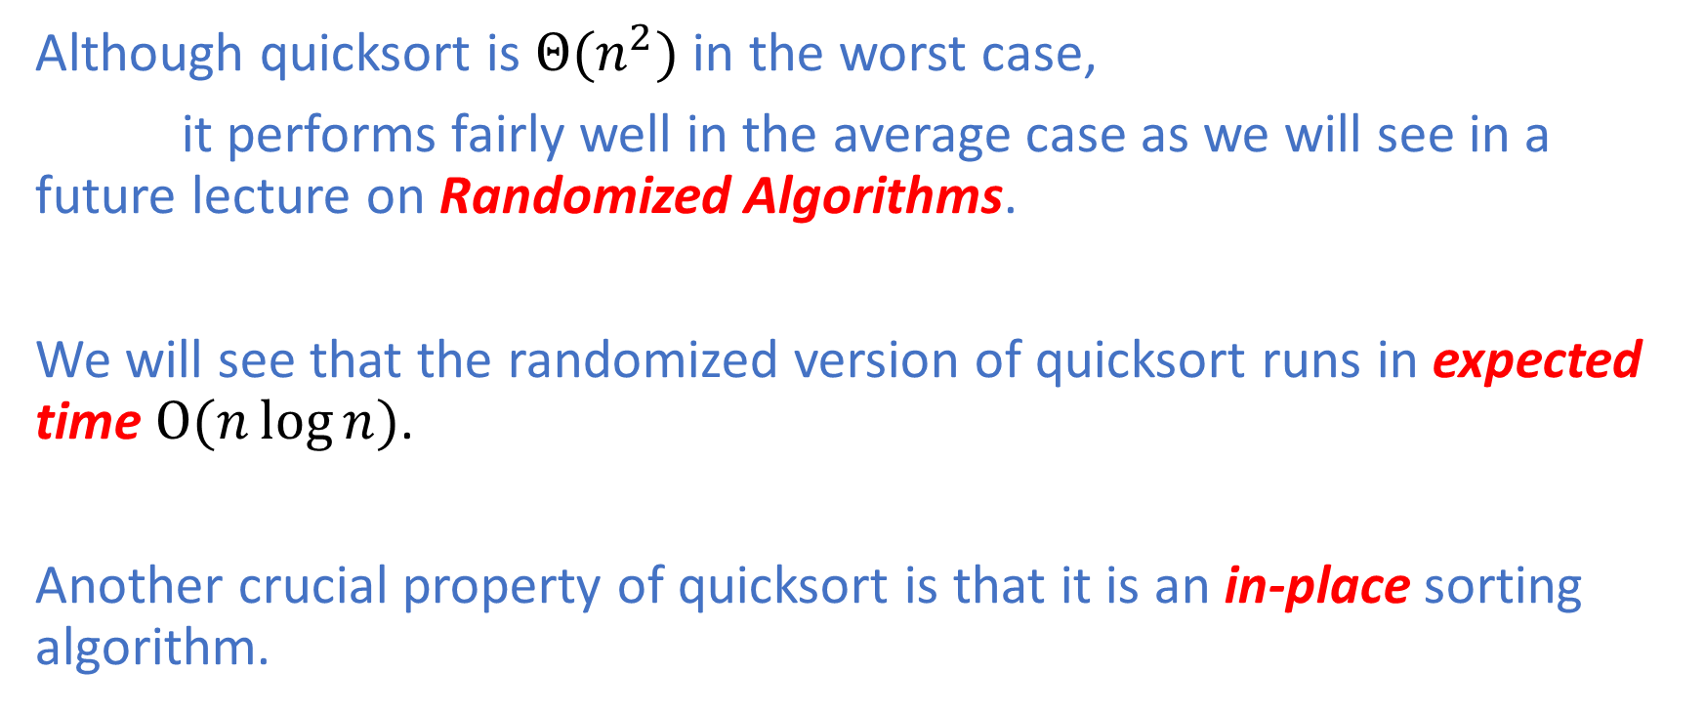
Quicksort
Although quicksort is $Θ(n^{2})$ in the worst case,
it performs fairly well in the average case as we will see in a future lecture on Randomized Algorithms.
We will see that the randomized version of quicksort runs in expected time $O(n\log{n})$.
Another crucial property of quicksort is that it is an in-place sorting algorithm.

Slide 23
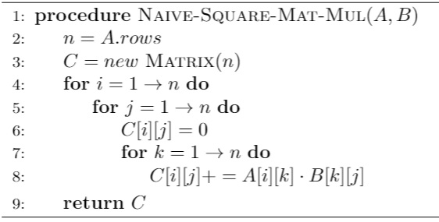
Matrix Multiplication: Naïve Algorithm
Naïve matrix multiplication can be implemented in an iterative fasion as follows:

Slide 24
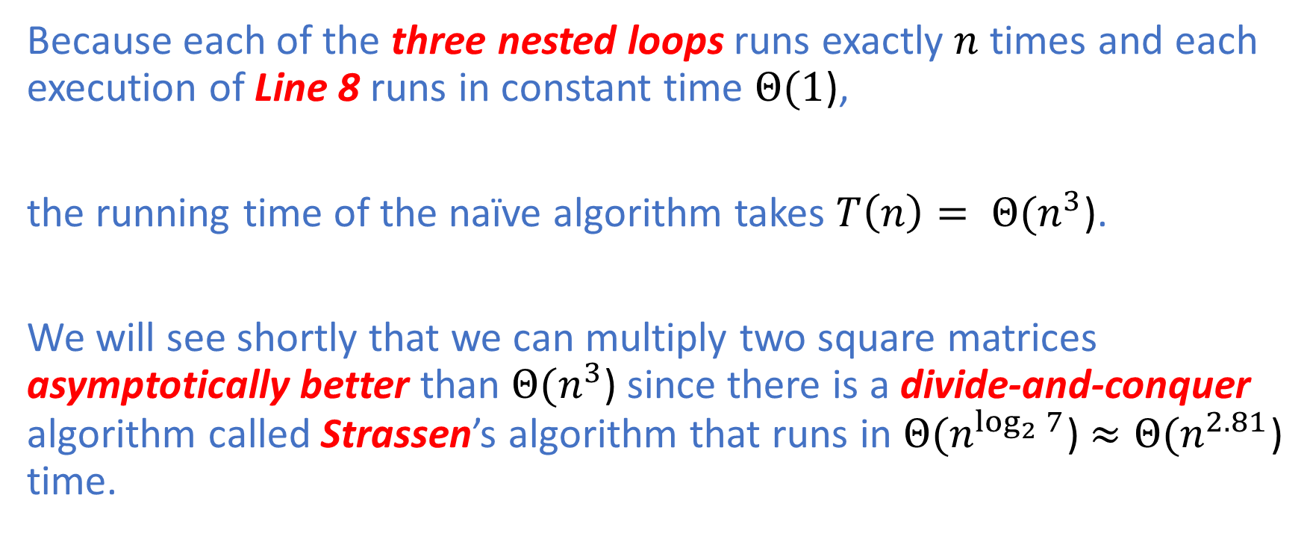
Matrix Multiplication: Naïve Algorithm
Because each of the three nested loops runs exactly $n$ times and each execution of Line 8 runs in constant time $Θ(1$),
the running time of the naïve algorithm takes $T\left(n\right)= Θ(n^{3}$).
We will see shortly that we can multiply two square matrices asymptotically better than $Θ(n^{3}$) since there is a divide-and-conquer algorithm called Strassen’s algorithm that runs in $Θ(n^{\log_{2}{7}}$) $≈Θ(n^{2.81}$) time.

Slide 25
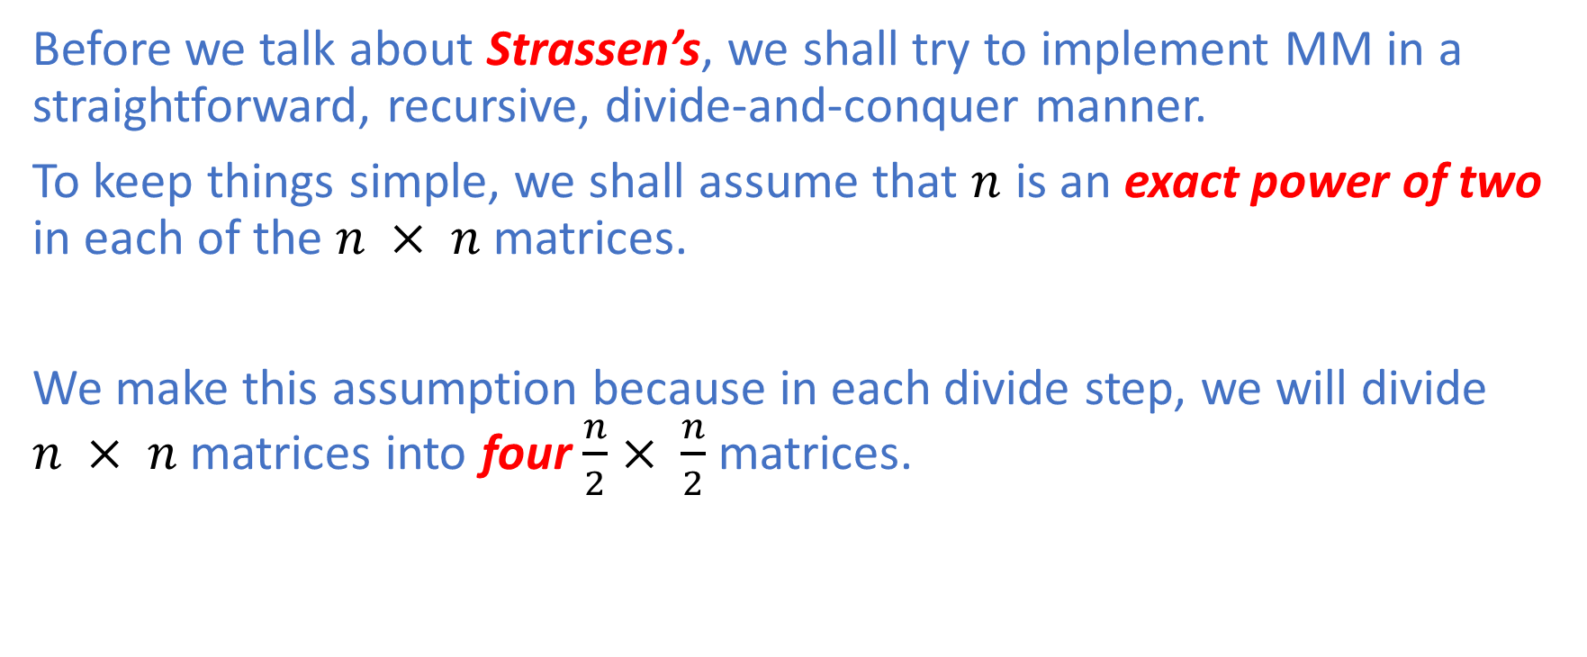
Matrix Multiplication: Naïve DQ Algorithm
Before we talk about Strassen’s, we shall try to implement MM in a straightforward, recursive, divide-and-conquer manner.
To keep things simple, we shall assume that $n$ is an exact power of two in each of the $n × n$ matrices.
We make this assumption because in each divide step, we will divide $n × n$ matrices into four $\frac{n}{2}× \frac{n}{2}$ matrices.

Slide 26
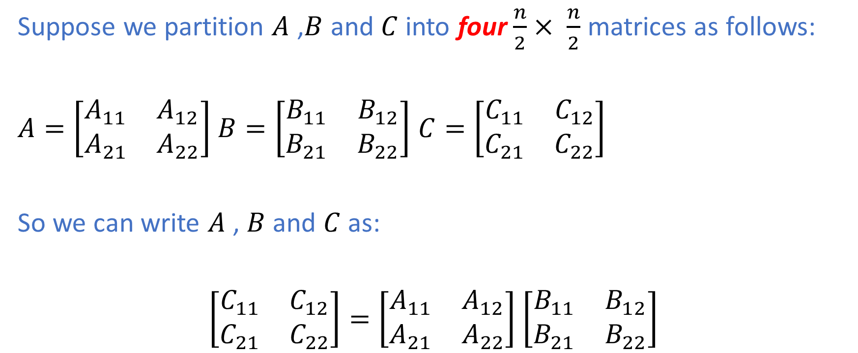
Naïve DQ MM Algorithm
Suppose we partition $A$ ,$B$ and $C$ into four $\frac{n}{2}× \frac{n}{2}$ matrices as follows:
$A=\left[\begin{matrix}A_{11} & A_{12} \\ A_{21} & A_{22}\end{matrix}\right]$ $B=\left[\begin{matrix}B_{11} & B_{12} \\ B_{21} & B_{22}\end{matrix}\right]$ $C=\left[\begin{matrix}C_{11} & C_{12} \\ C_{21} & C_{22}\end{matrix}\right]$
So we can write $A$ , $B$ and $C$ as:
$\left[\begin{matrix}C_{11} & C_{12} \\ C_{21} & C_{22}\end{matrix}\right]=\left[\begin{matrix}A_{11} & A_{12} \\ A_{21} & A_{22}\end{matrix}\right]$ $\left[\begin{matrix}B_{11} & B_{12} \\ B_{21} & B_{22}\end{matrix}\right]$

Slide 27
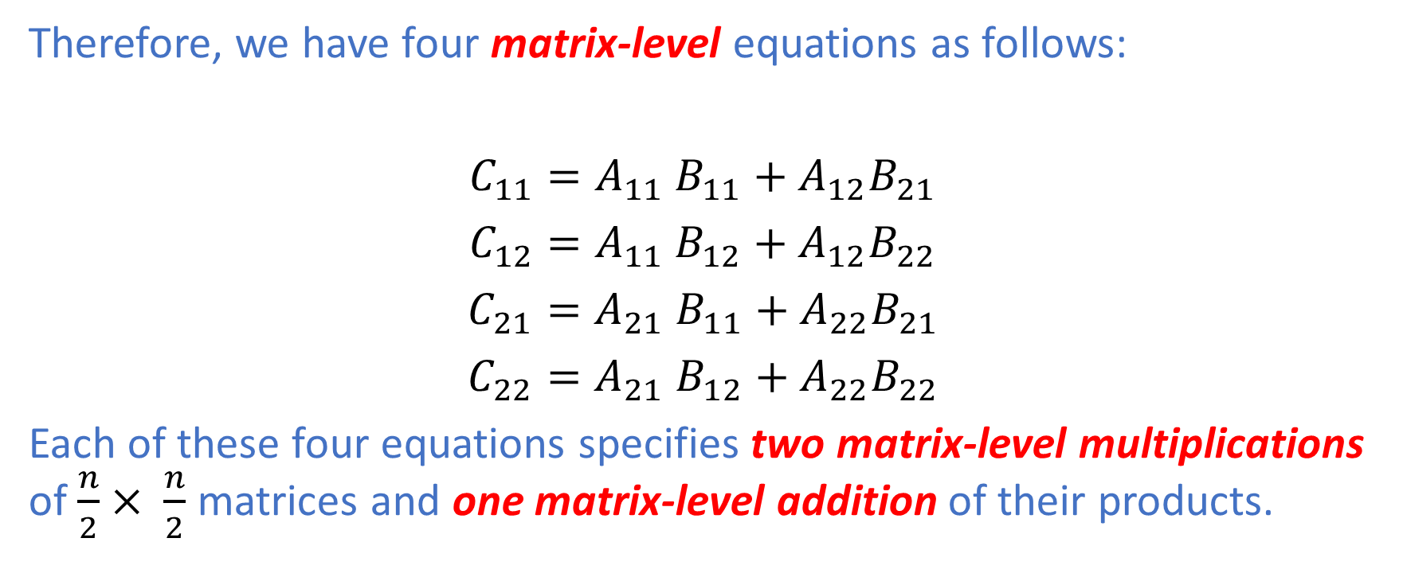
Naïve DQ MM Algorithm
Therefore, we have four matrix-level equations as follows:
$C_{11}=A_{11}$ $B_{11}+A_{12}B_{21}$
$C_{12}=A_{11}$ $B_{12}+A_{12}B_{22}$
$C_{21}=A_{21}$ $B_{11}+A_{22}B_{21}$
$C_{22}=A_{21}$ $B_{12}+A_{22}B_{22}$
Each of these four equations specifies two matrix-level multiplications of $\frac{n}{2}× \frac{n}{2}$ matrices and one matrix-level addition of their products.

Slide 28
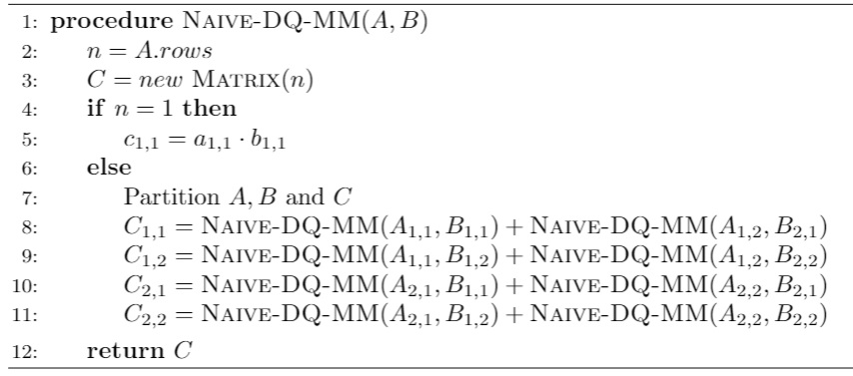
Naïve DQ MM Algorithm
Therefore, we can use these equations to create a straightforward recursive divide-and-conquer algorithm for MM.

Slide 29
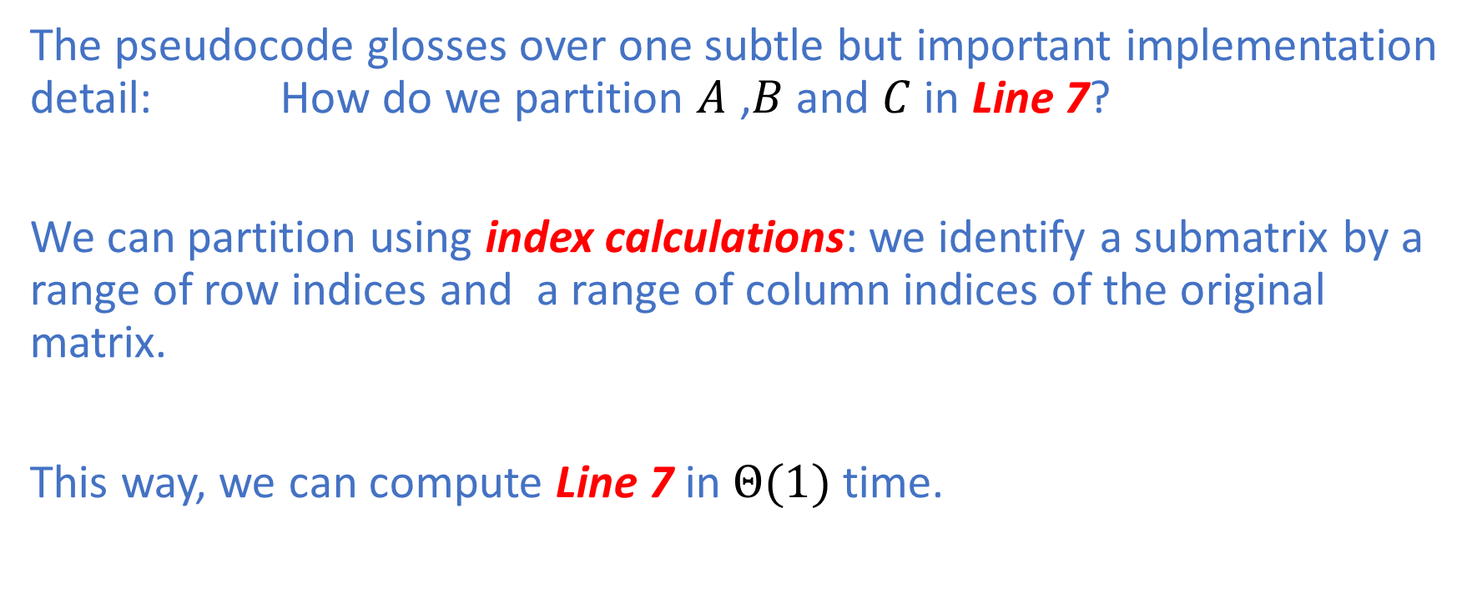
Naïve DQ MM Algorithm: Running Time
The pseudocode glosses over one subtle but important implementation detail: How do we partition $A$ ,$B$ and $C$ in Line 7?
We can partition using index calculations: we identify a submatrix by a range of row indices and a range of column indices of the original matrix.
This way, we can compute Line 7 in $Θ(1)$ time.

Slide 30
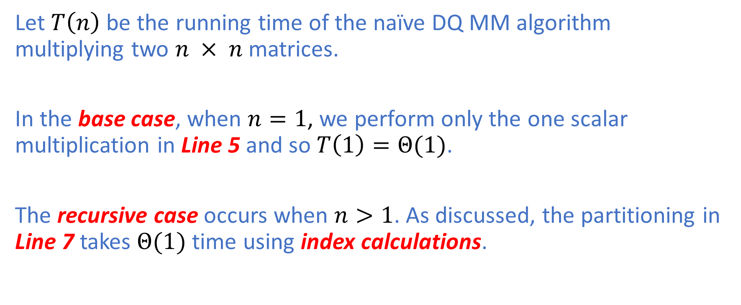
Naïve DQ MM Algorithm: Running Time
Let $T\left(n\right)$ be the running time of the naïve DQ MM algorithm multiplying two $n × n$ matrices.
In the base case, when $n=1$, we perform only the one scalar multiplication in Line 5 and so $T\left(1\right)=Θ(1)$.
The recursive case occurs when $n>1$. As discussed, the partitioning in Line 7 takes $Θ(1)$ time using index calculations.

Slide 31
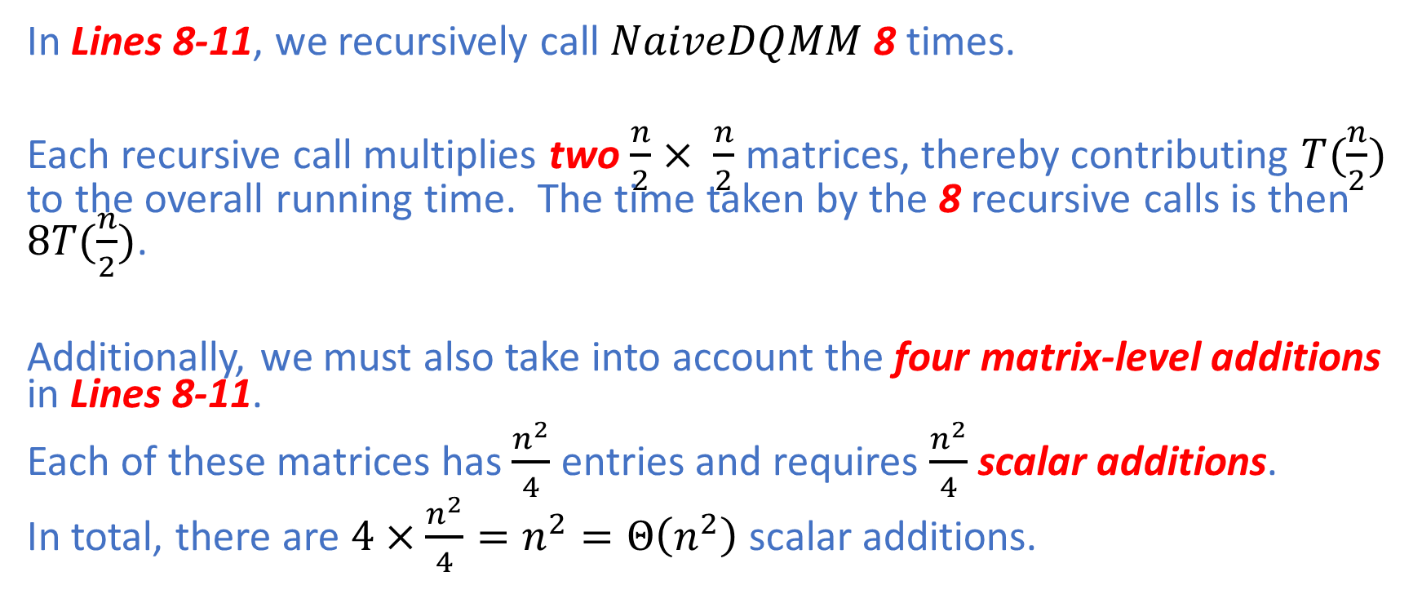
Naïve DQ MM Algorithm: Running Time
In Lines 8-11, we recursively call $NaiveDQMM$ 8 times.
Each recursive call multiplies two $\frac{n}{2}× \frac{n}{2}$ matrices, thereby contributing $T(\frac{n}{2})$ to the overall running time. The time taken by the 8 recursive calls is then $8T(\frac{n}{2})$.
Additionally, we must also take into account the four matrix-level additions in Lines 8-11.
Each of these matrices has $\frac{n^{2}}{4}$ entries and requires $\frac{n^{2}}{4}$scalar additions.
In total, there are $4×\frac{n^{2}}{4}=n^{2}=Θ\left(n^{2}\right)$ scalar additions.

Slide 32
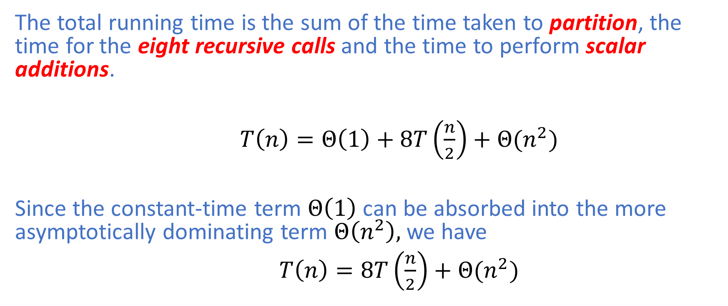
Naïve DQ MM Algorithm: Running Time
The total running time is the sum of the time taken to partition, the time for the eight recursive calls and the time to perform scalar additions.
$T\left(n\right)=Θ\left(1\right)+8T\left(\frac{n}{2}\right)+Θ(n^{2})$
Since the constant-time term $Θ\left(1\right)$ can be absorbed into the more asymptotically dominating term $Θ\left(n^{2}\right),$ we have
$T\left(n\right)=8T\left(\frac{n}{2}\right)+Θ(n^{2})$

Slide 33
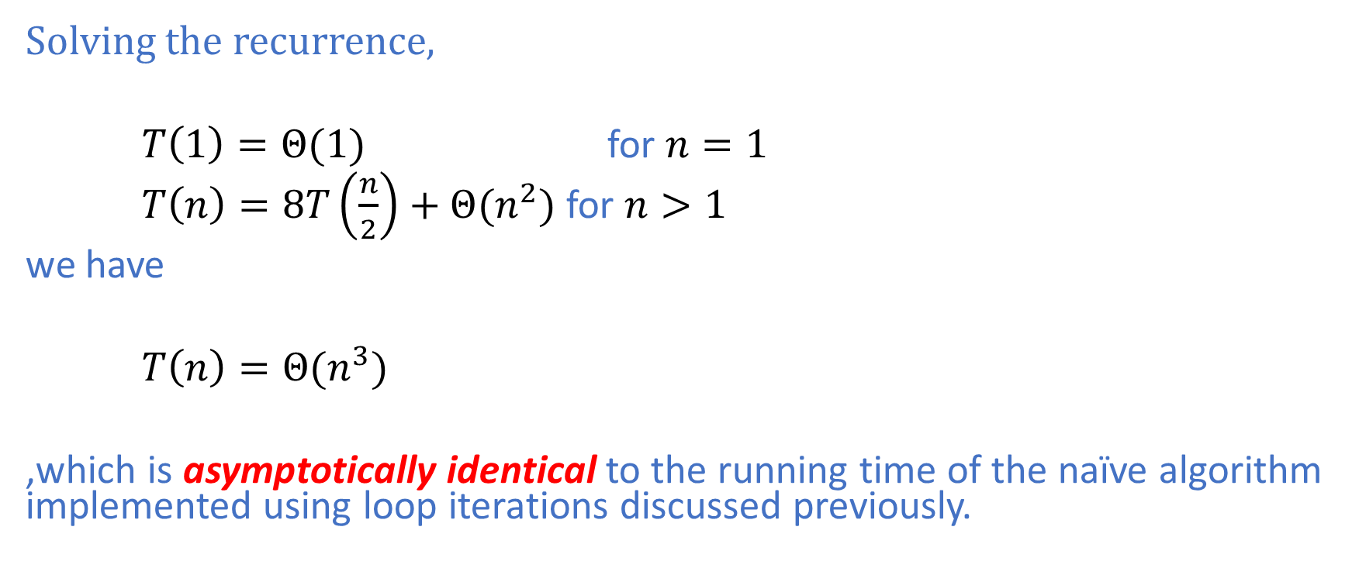
Naïve DQ MM Algorithm: Running Time
Solving the recurrence,
$T\left(1\right)=Θ(1)$ for $n=1$
$T\left(n\right)=8T\left(\frac{n}{2}\right)+Θ(n^{2})$ for $n>1$
we have
$T\left(n\right)=Θ(n^{3})$
,which is asymptotically identical to the running time of the naïve algorithm implemented using loop iterations discussed previously.

Slide 34
Strassen’s Algorithm
The key idea of Strassen’s algorithm is to make the recursion tree slightly less bushy.
Instead of performing eight matrix-level multiplications in each recursive call, it performs only seven.
The cost of eliminating one matrix-level multiplication will increase the number of matrix-level additions/subtractions to 18.

Slide 35
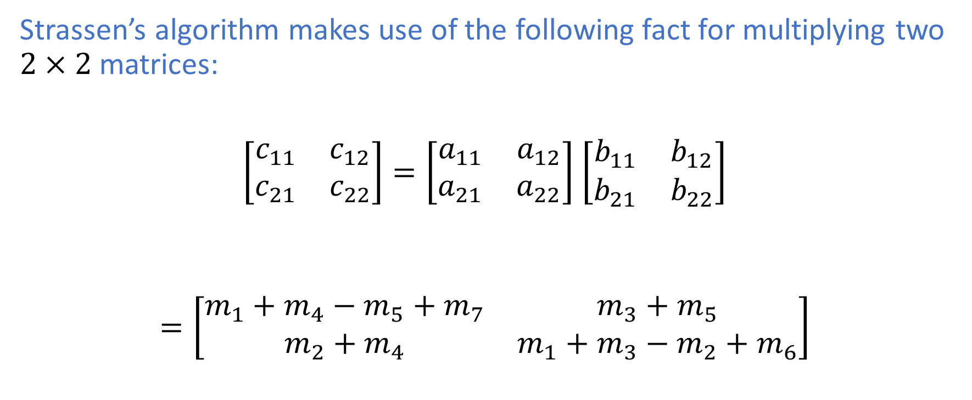
Strassen’s Algorithm
Strassen’s algorithm makes use of the following fact for multiplying two $2×2$ matrices:
$\left[\begin{matrix}c_{11} & c_{12} \\ c_{21} & c_{22}\end{matrix}\right]=\left[\begin{matrix}a_{11} & a_{12} \\ a_{21} & a_{22}\end{matrix}\right]$ $\left[\begin{matrix}b_{11} & b_{12} \\ b_{21} & b_{22}\end{matrix}\right]$
$$=\left[\begin{matrix}m_{1}+m_{4}−m_{5}+m_{7} & m_{3}+m_{5} \\ m_{2}+m_{4} & m_{1}+m_{3}−m_{2}+m_{6}\end{matrix}\right]$$

Slide 36
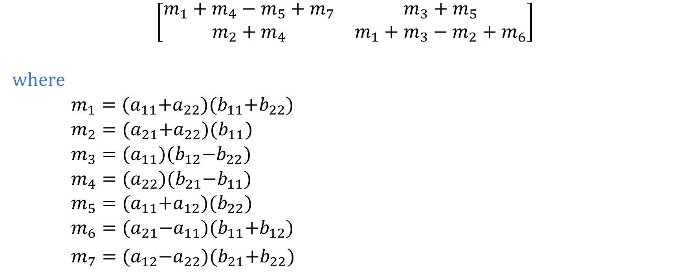
Strassen’s Algorithm
$$\left[\begin{matrix}m_{1}+m_{4}−m_{5}+m_{7} & m_{3}+m_{5} \\ m_{2}+m_{4} & m_{1}+m_{3}−m_{2}+m_{6}\end{matrix}\right]$$
where
$m_{1}={(a}_{11}+a_{22}){(b}_{11}+b_{22})$
$m_{2}={(a}_{21}+a_{22}){(b}_{11})$
$m_{3}={(a}_{11}){(b}_{12}−b_{22})$
$m_{4}={(a}_{22}){(b}_{21}−b_{11})$
$m_{5}={(a}_{11}+a_{12}){(b}_{22})$
$m_{6}={(a}_{21}−a_{11}){(b}_{11}+b_{12})$
$m_{7}={(a}_{12}−a_{22}){(b}_{21}+b_{22})$

Slide 37
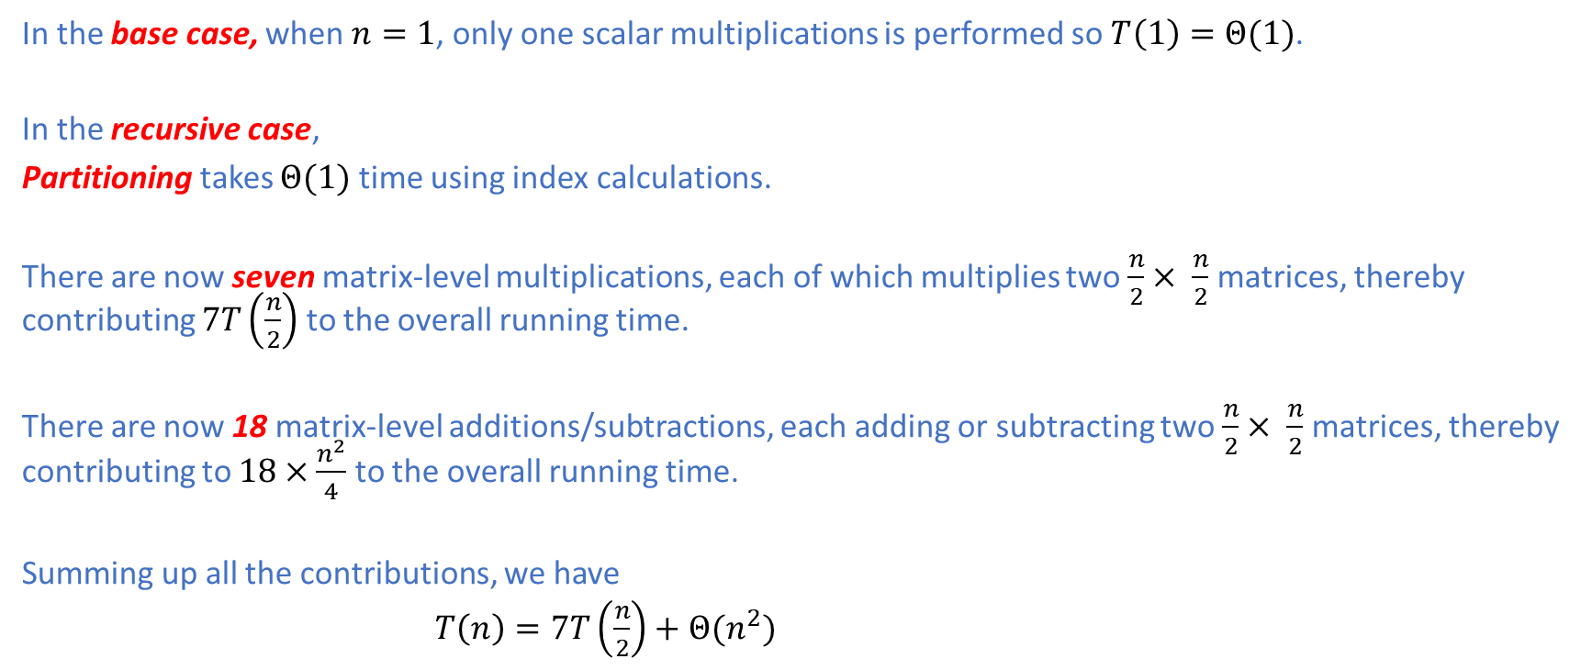
Strassen’s Algorithm: Analysis
In the base case, when $n=1$, only one scalar multiplications is performed so $T\left(1\right)=Θ(1)$.
In the recursive case,
Partitioning takes $Θ(1)$ time using index calculations.
There are now seven matrix-level multiplications, each of which multiplies two $\frac{n}{2}× \frac{n}{2}$matrices, thereby contributing $7T\left(\frac{n}{2}\right)$ to the overall running time.
There are now 18 matrix-level additions/subtractions, each adding or subtracting two $\frac{n}{2}× \frac{n}{2}$matrices, thereby contributing to $18×\frac{n^{2}}{4}$ to the overall running time.
Summing up all the contributions, we have
$T\left(n\right)=7T\left(\frac{n}{2}\right)+$ $Θ(n^{2})$

Slide 38
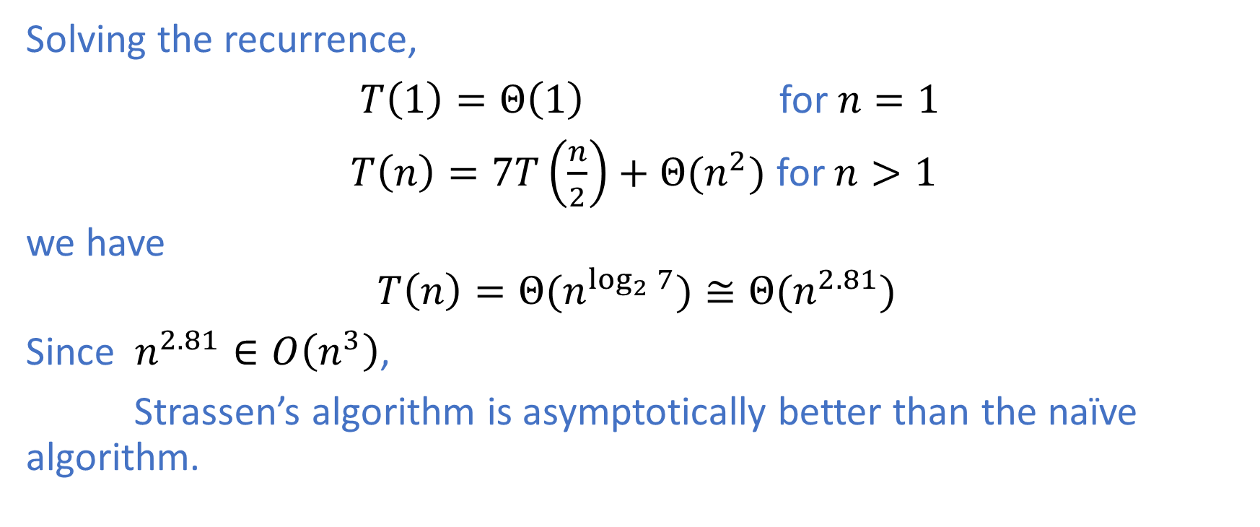
Strassen’s Algorithm: Analysis
Solving the recurrence,
$T\left(1\right)=Θ\left(1\right) \text{for} n=1$
$T\left(n\right)=7T\left(\frac{n}{2}\right)+$ $Θ(n^{2})$ for $n>1$
we have
$$T\left(n\right)=Θ(n^{\log_{2}{7}})≅Θ(n^{2.81})$$
Since $n^{2.81}∈O\left(n^{3}\right)$,
Strassen’s algorithm is asymptotically better than the naïve algorithm.

Slide 39
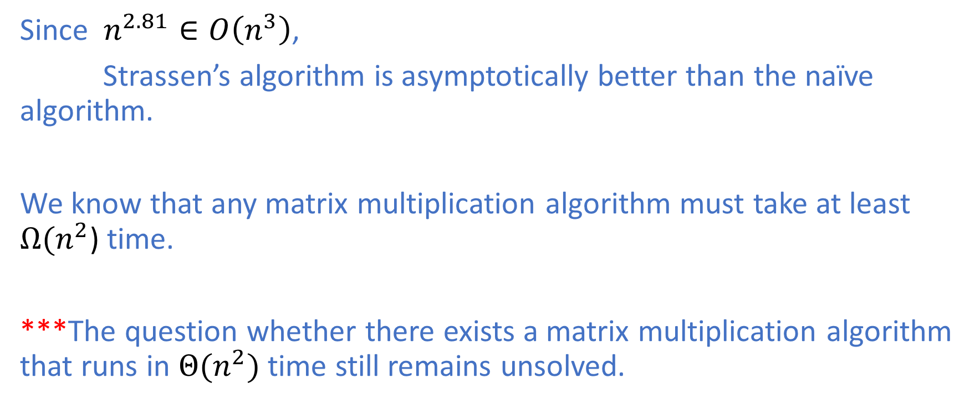
Strassen’s Algorithm: Analysis
Since $n^{2.81}∈O\left(n^{3}\right)$,
Strassen’s algorithm is asymptotically better than the naïve algorithm.
We know that any matrix multiplication algorithm must take at least $Ω(n^{2}$) time.
***The question whether there exists a matrix multiplication algorithm that runs in $Θ(n^{2})$ time still remains unsolved.

Slide 40
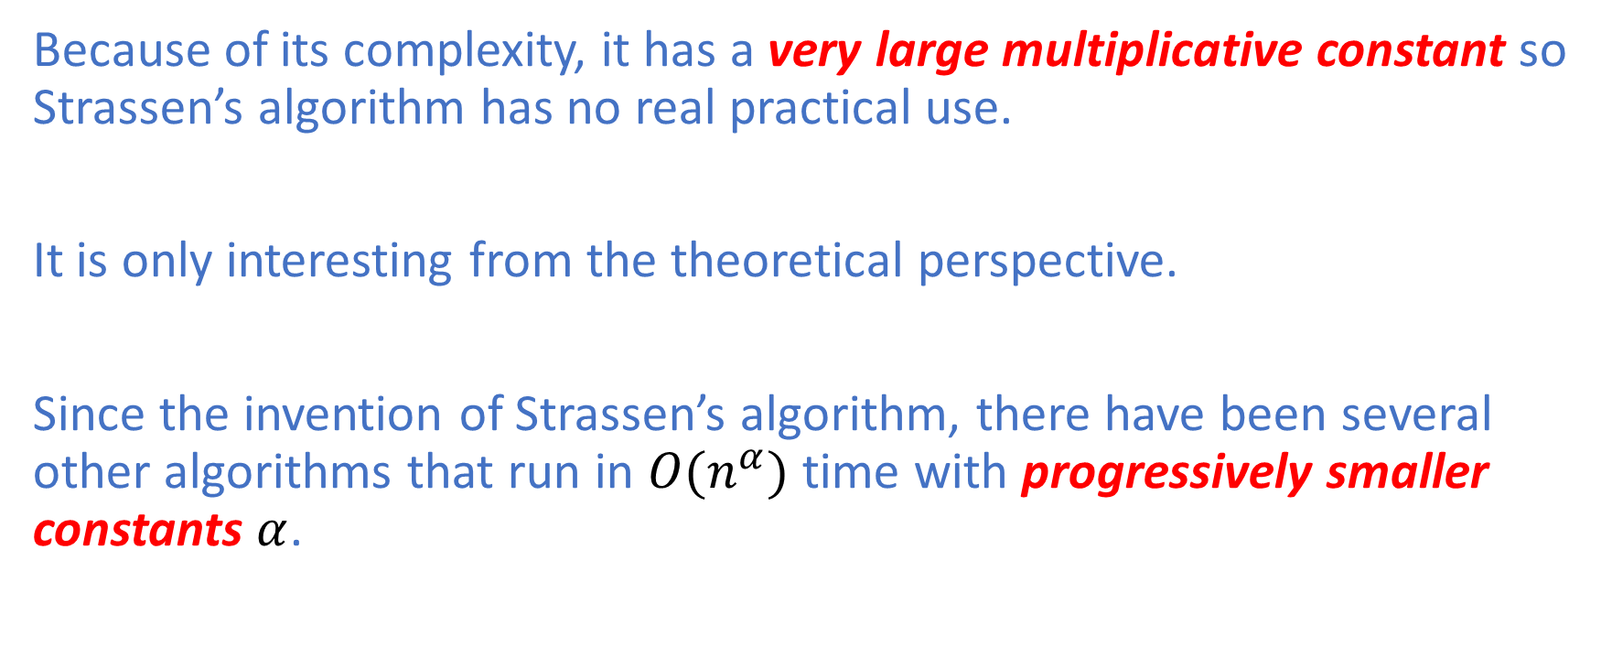
Strassen’s Algorithm: No Practical Use
Because of its complexity, it has a very large multiplicative constant so Strassen’s algorithm has no real practical use.
It is only interesting from the theoretical perspective.
Since the invention of Strassen’s algorithm, there have been several other algorithms that run in ${O(n}^{α})$ time with progressively smaller constants $α$.

Slide 41
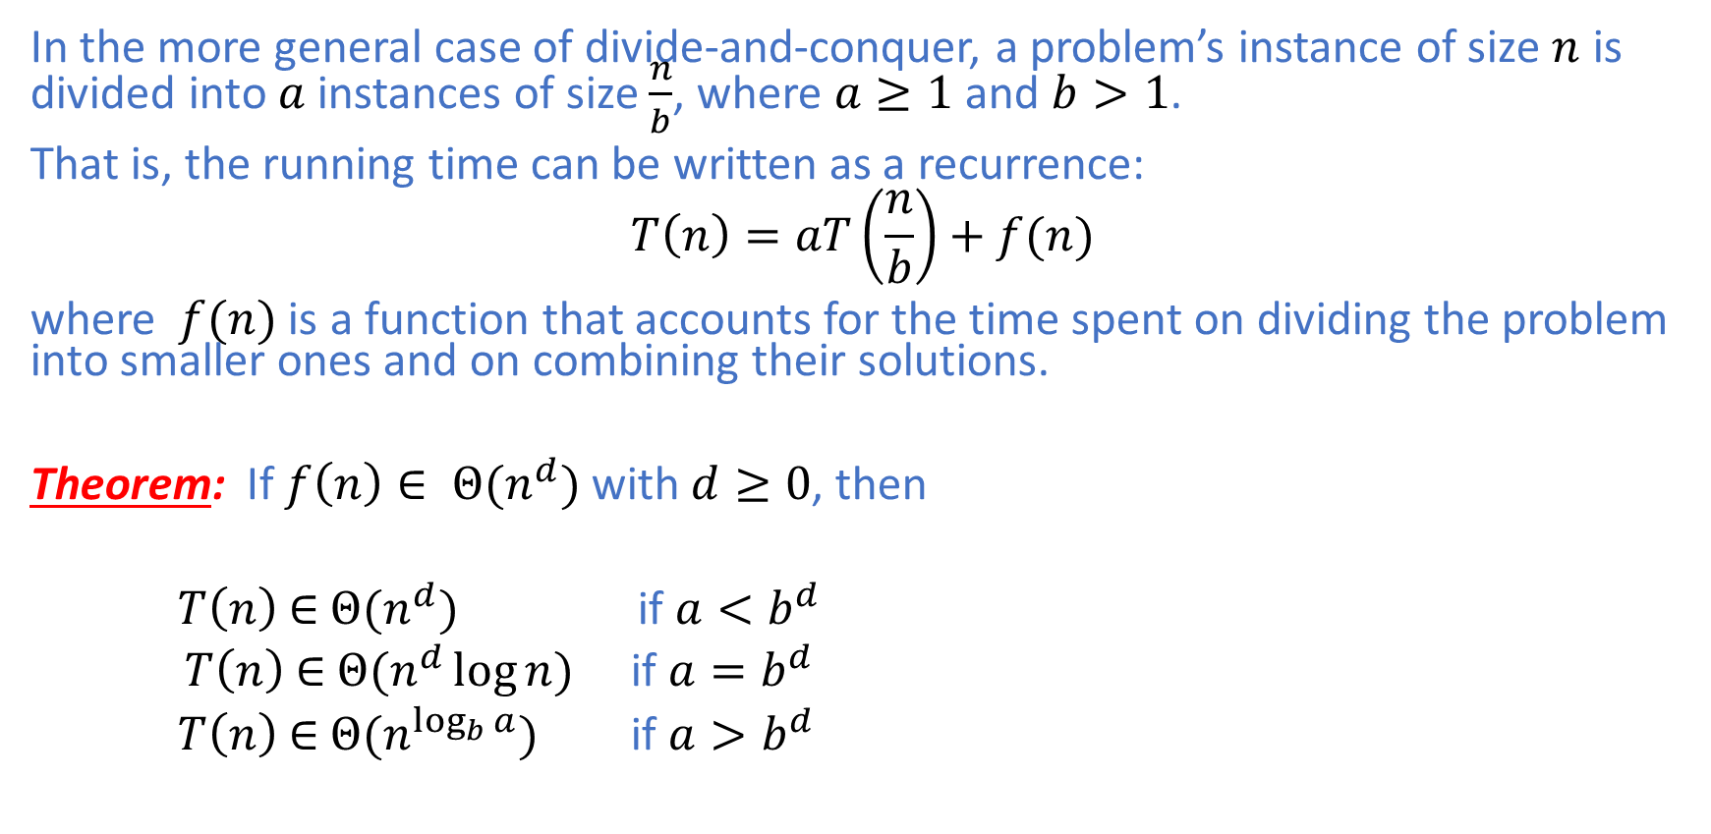
Master Theorem
In the more general case of divide-and-conquer, a problem’s instance of size $n$ is divided into $a$ instances of size $\frac{n}{b}$, where $a≥1$ and $b>1$.
That is, the running time can be written as a recurrence:
$$T\left(n\right)=aT\left(\frac{n}{b}\right)+f(n)$$
where $f(n)$ is a function that accounts for the time spent on dividing the problem into smaller ones and on combining their solutions. Theorem: If $f\left(n\right)∈ Θ(n^{d})$ with $d≥0$, then
$T\left(n\right)$ $∈$ $Θ(n^{d})$ if $a<b^{d}$
$T\left(n\right)$ $∈$ $Θ(n^{d}\log{n})$ if $a=b^{d}$
$T\left(n\right)$ $∈$ $Θ(n^{\log_{b}{a}})$ if $a>b^{d}$

Slide 42
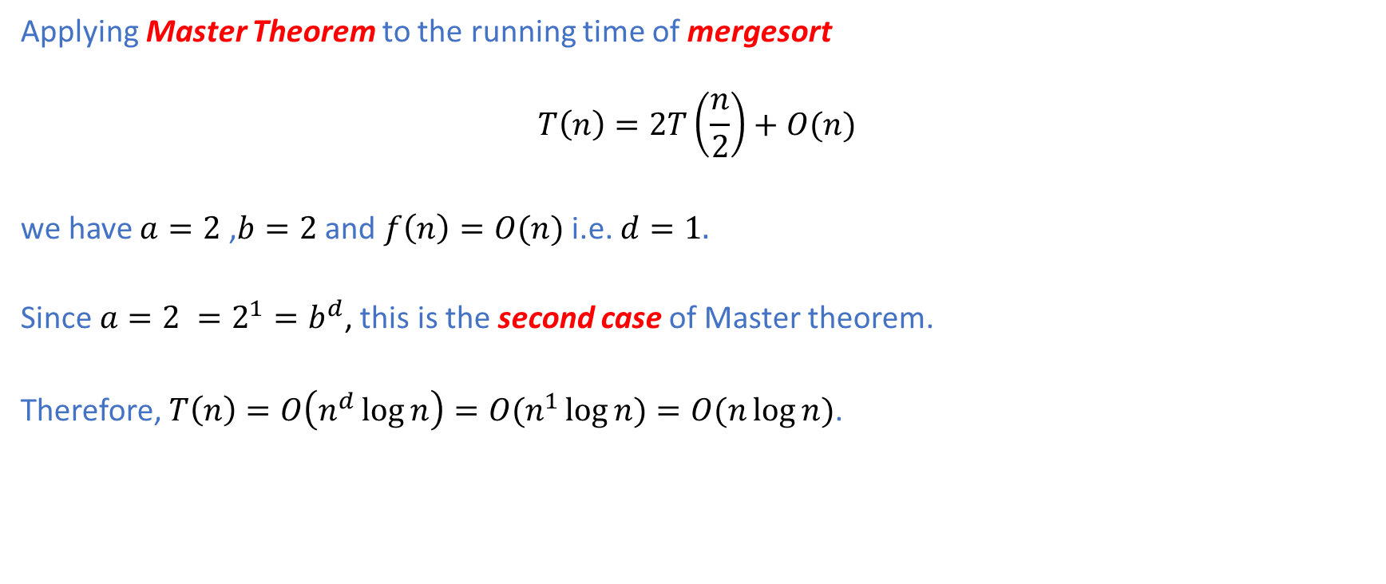
Master Theorem: Example
Applying Master Theorem to the running time of mergesort
$$T\left(n\right)=2T\left(\frac{n}{2}\right)+O(n)$$
we have $a=2$ ,$b=2$ and $f\left(n\right)=O(n)$ i.e. $d=1.$
Since $a=2 =2^{1}=b^{d}$, this is the second case of Master theorem.
Therefore, $T\left(n\right)=O\left(n^{d}\log{n}\right)={O(n}^{1}\log{n)=O(n\log{n)}}$.

Slide 43
Summary
We have covered the following topics:
The Three-Step Process in the Divide-and-Conquer Paradigm.
Quick Sort
Matrix Multiplication: Native and Strassen’s Method
Master Theorem
In the next lecture, we will cover dynamic programming.

